Slide 1


Slide 2
Introduction to Access – Part 7 Using Field Properties
Using Field Properties-
Input Masks
Required Fields
Validation Rules
Validation Text

Slide 3
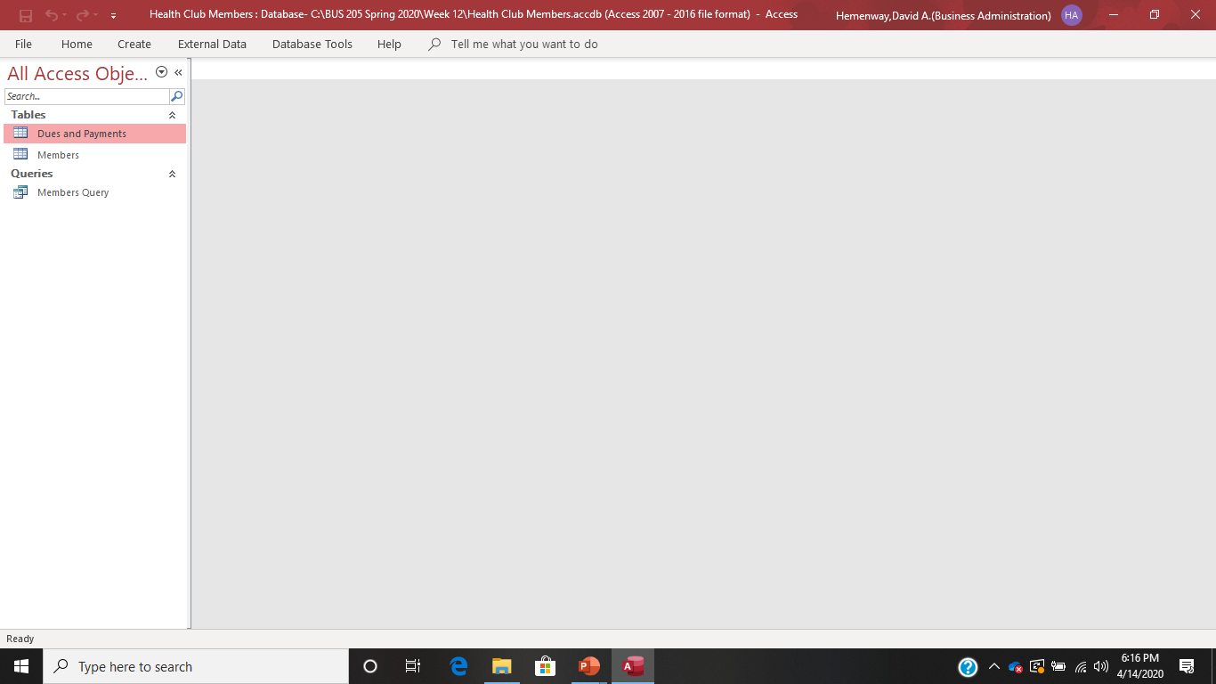
Get the Health Club Members database from Blackboard Week 12

Slide 4
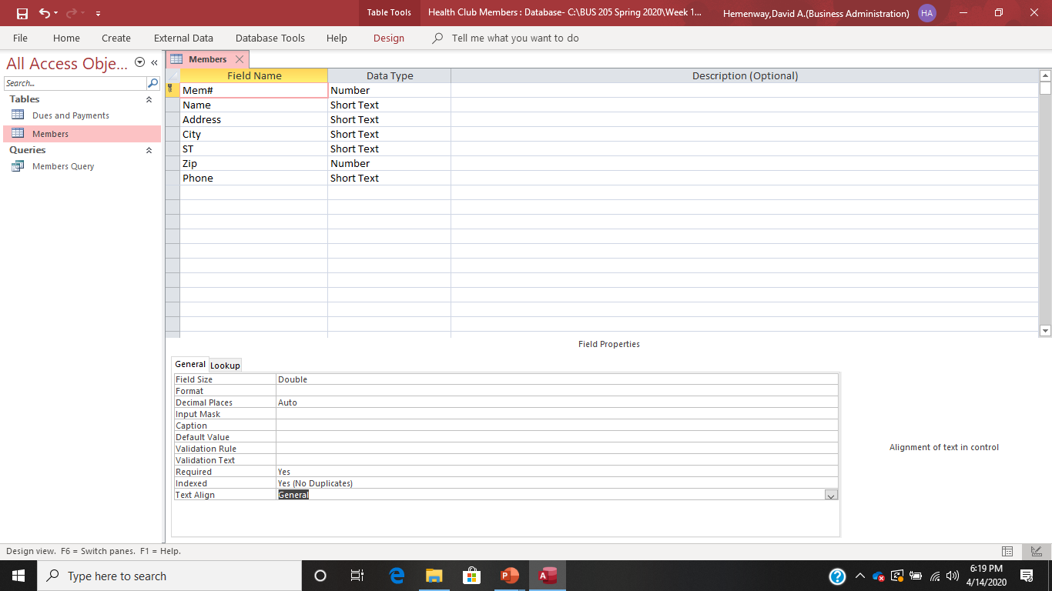
Open the Members Table and switch to DesignView

Slide 5
Input Masks
Input masks help you enter data.
They format it to make it easer to read but do not change it in the database. It only changes what you see.
Go down to the Phone Field and select it.
Go down to Input Mask on the lower screen.
Look at the drop-down menu on the right side of the screen where there are three dots.
Select the Phone Number format from these options.

Slide 6
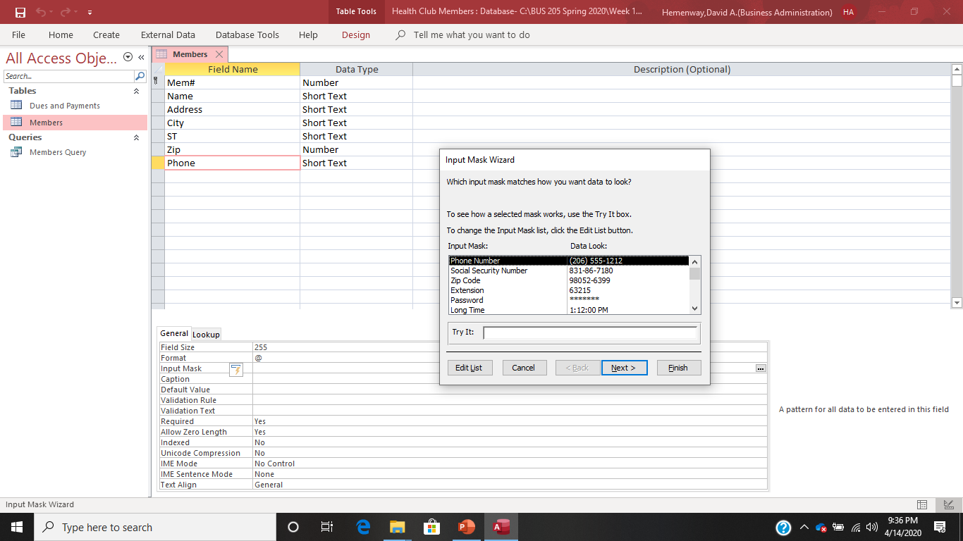
Now your screen should look like this. Select the Input Mask you want, i.e. Phone Number, and select Finish

Slide 7
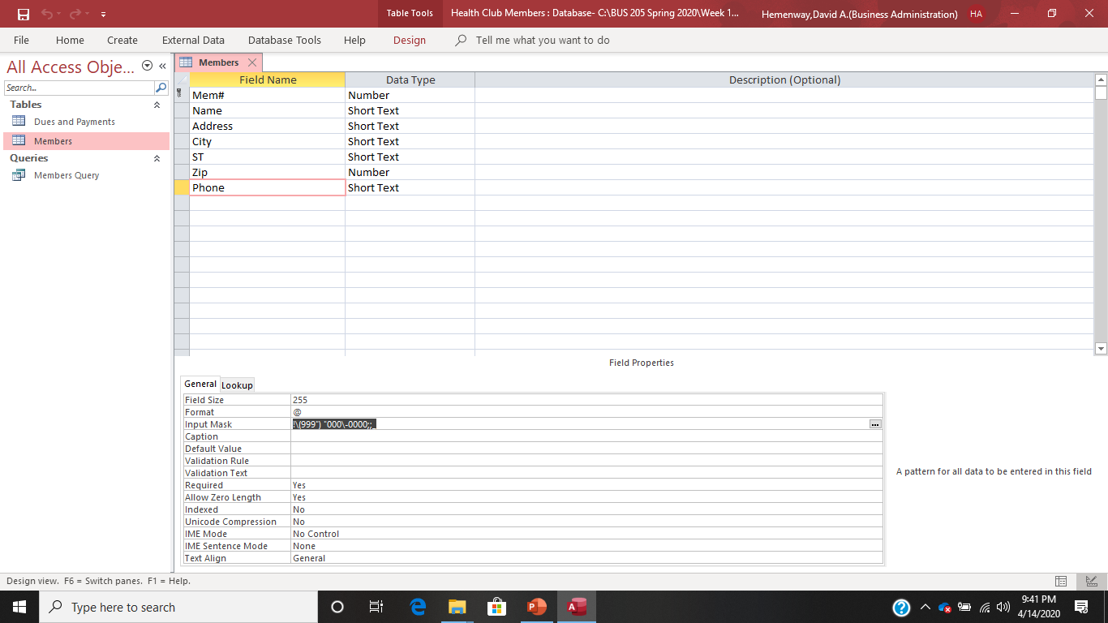
You have now made an Input Mask for the field Phone in the Members Table.

Slide 8
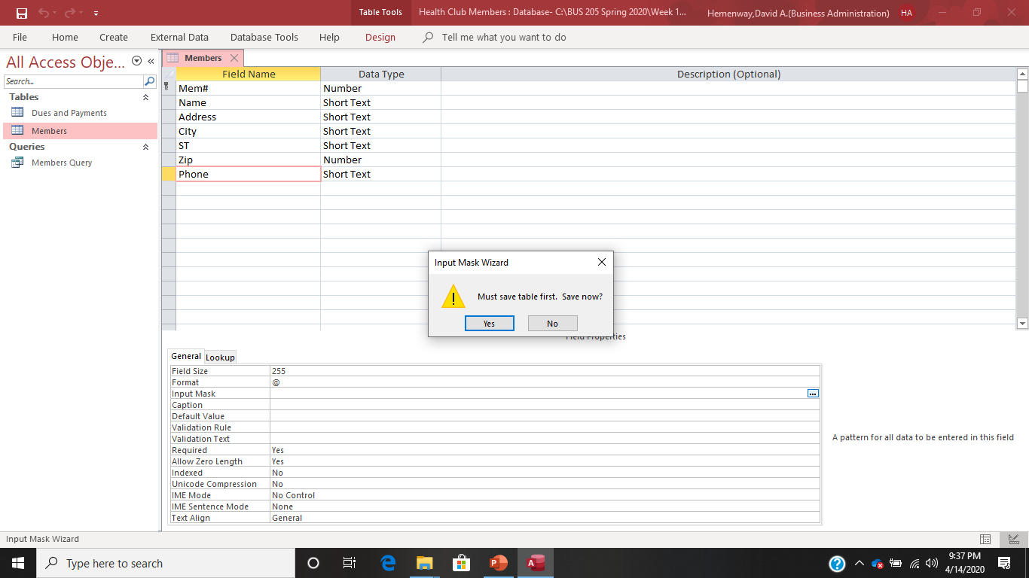
In the Members table in Design View, highlight Phone and move your cursor to the Input Mask row and select the three dots at the right end of the row. If you might get this message, select Yes.

Slide 9
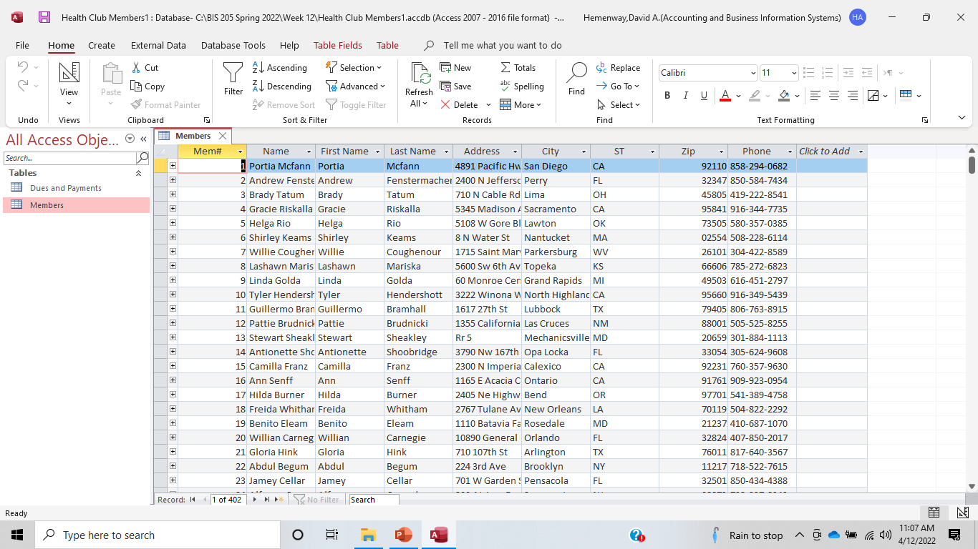

Slide 10
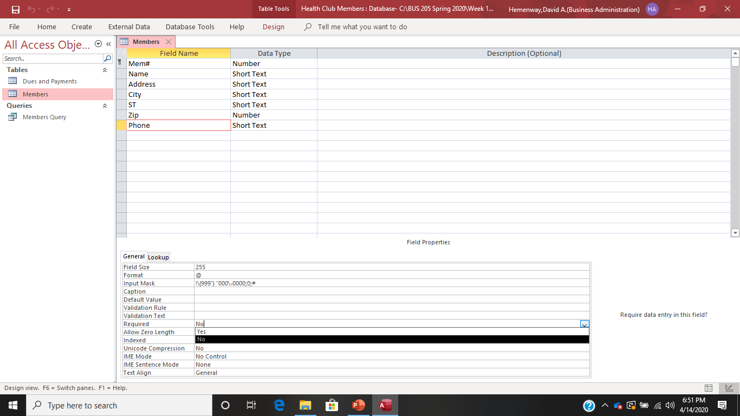
Required Fields Required fields change a variable to require it to be entered before a record is entered into a database. Let’s make the telephone field a required field by highlighting Phone and then going down to the Required row in Field Properties and selecting the Yes option with the down arrow key on the right.

Slide 11
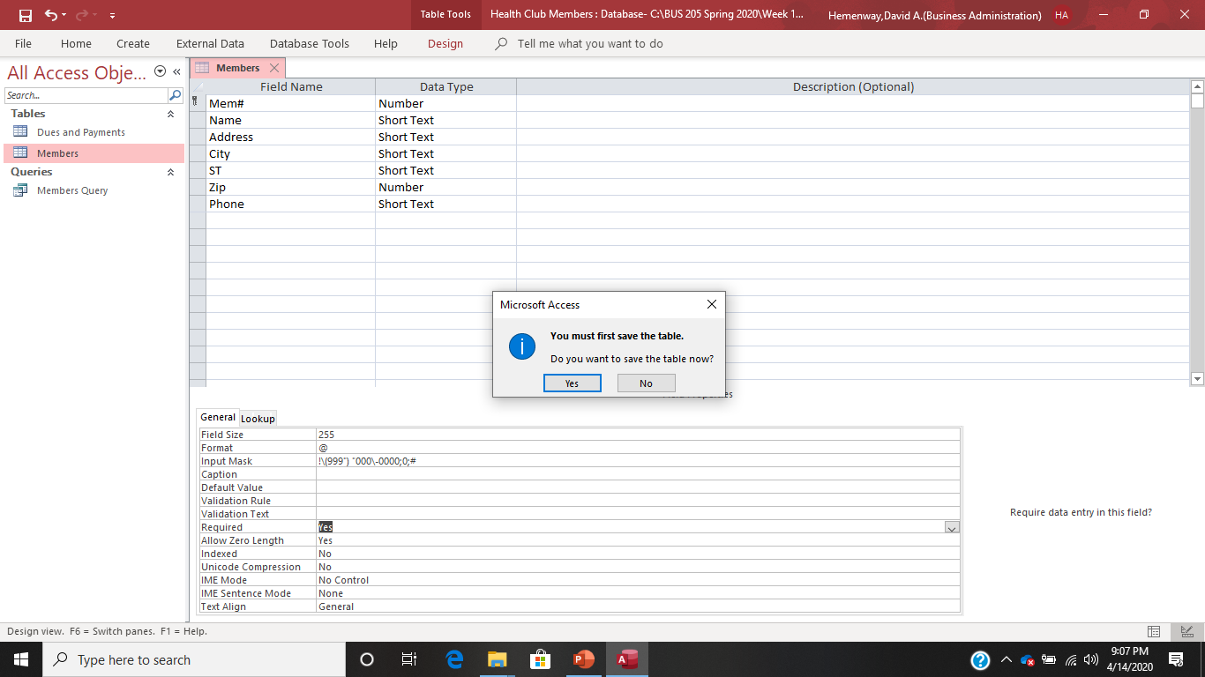
Now let’s go to the Datasheet View screen and see if our telephone required field is working. When you attempt to go to Datasheet View, this may happen! Select the Yes option to save the table.

Slide 12
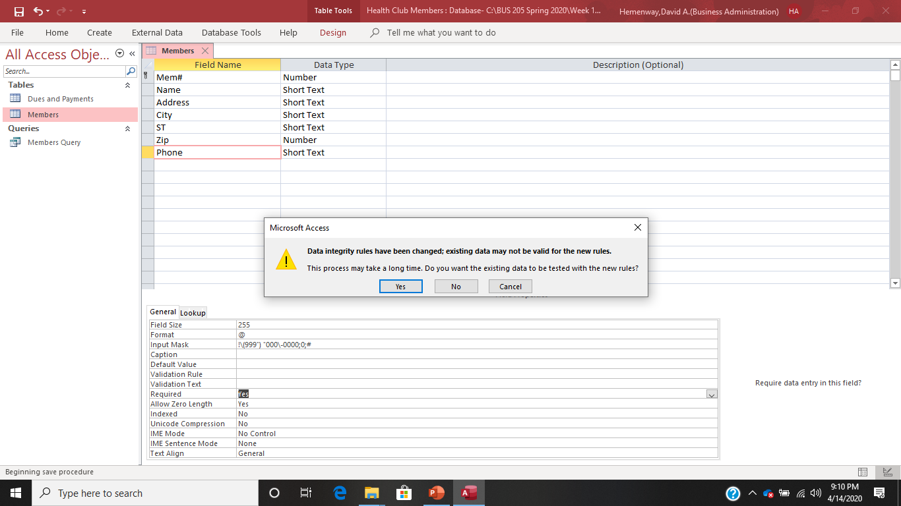
Now you will get this option. Select Yes if you want to see if all the data complies with your new rule, otherwise select No.

Slide 13
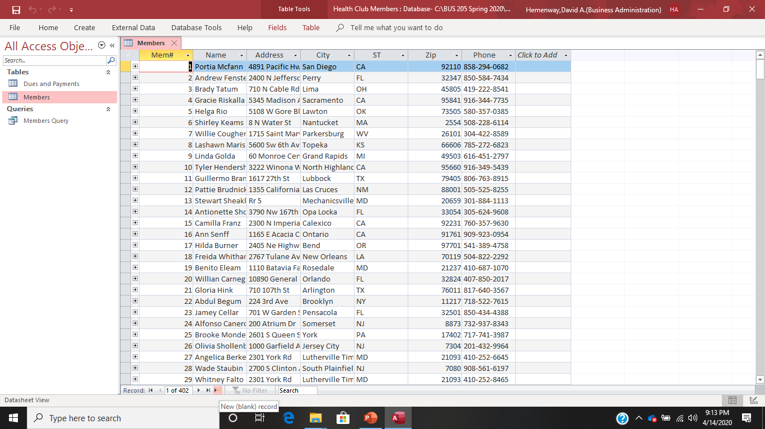
Now we are finally at the Datasheet View screen and we can attempt to add a new record to see if our telephone requirement works.

Slide 14
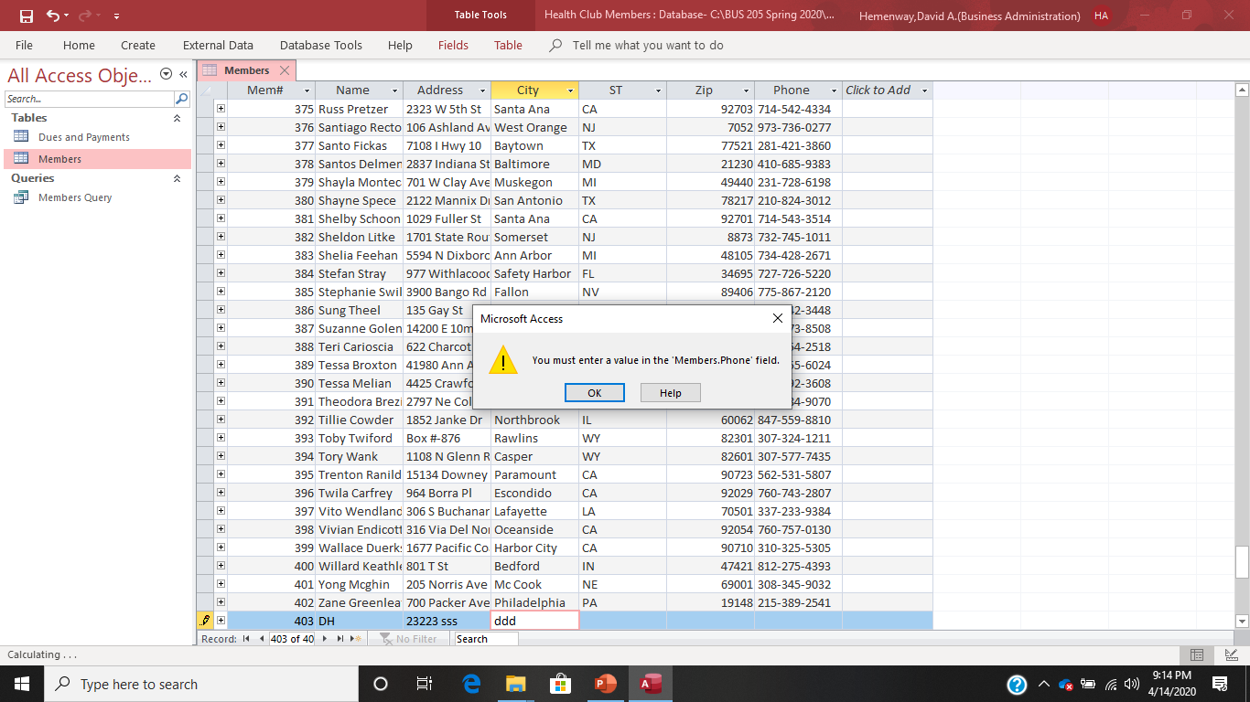
Put some bogus data into some fields, but don’t put anything in the telephone filed and hit enter. It works! Yippie!!!

Slide 15
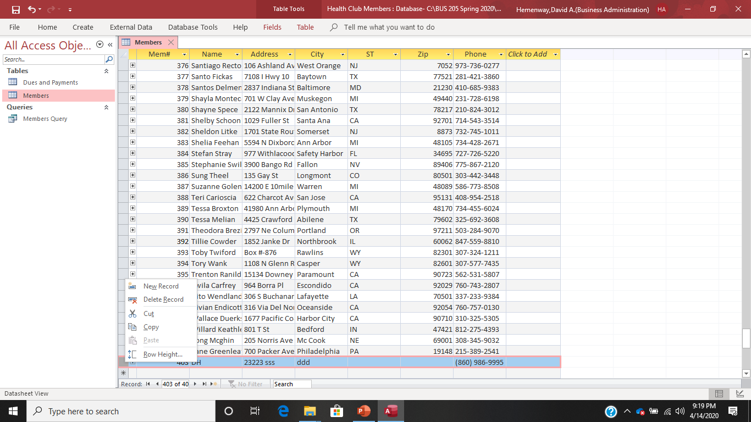
If you right click on the leftmost column or the one next to it, you get the option of deleting this fake record. Do it because we don’t want our database messed up.

Slide 16
Validation Rules
A validation rule limits or controls what users can enter in a table field or a control.
You can think of validation rules as a set of layers — you can use some or all of the layers when you need to ensure that your users enter data properly. You can also use the Validation Rule property to require specific values, and the Validation Text property to alert your users to any mistakes.
For example, entering a rule such as >100 And <1000 in the Validation Rule property forces users to enter values between 100 and 1,000. The Validation data must be a number greater than 100 and less than 1000.

Slide 17
Operators for Expression Builder Source: Weverka, Peter, Microsoft Office 2019, 2019
Operator | Name | Example
< | Less than | <10, any number smaller than ten
<= | Less than or equal to | <=10, ten as well as any number less than ten
> | Greater than | >10, any number larger than ten
>= | Greater than or equal to | >=10, ten as well as any number larger than ten
= | Equal to | =10, ten and no other numbers
<> (you can enter the word not) | Not equal to | <>10, all numbers except ten
Between…And… | Between | Between 10 and 15, a number between 10 and 15 or equal to 10 and 15

Slide 18
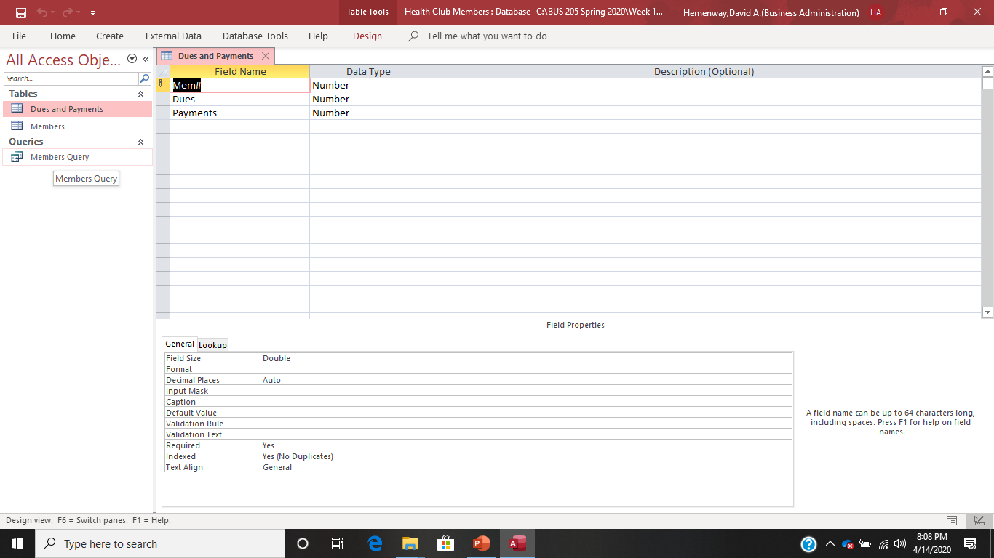
Validation Rule Example Open the Dues and Payments Table in Design View

Slide 19
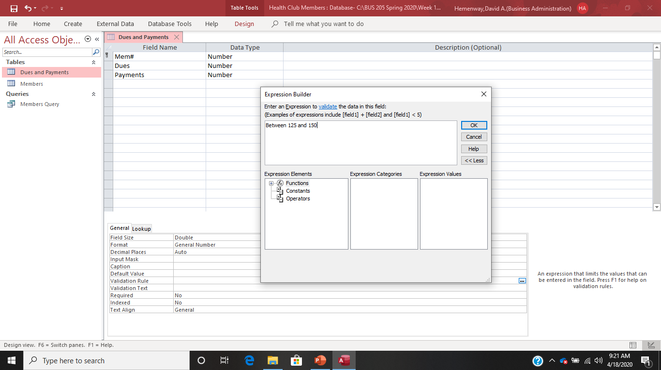
Click on the Dues field and move your cursor to the Validation Rule area and click on it, three dots will appear on that row, click on them to get this screen:

Slide 20
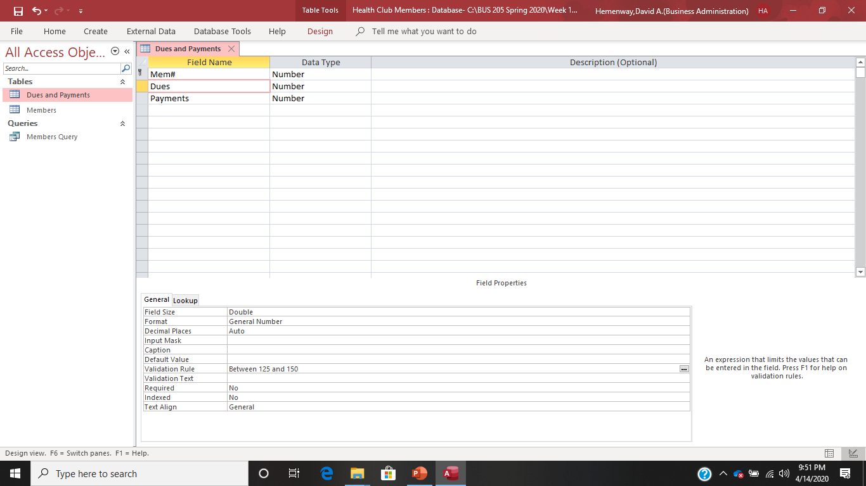
Key in your validation rule of dues must be between 125 and 150

Slide 21
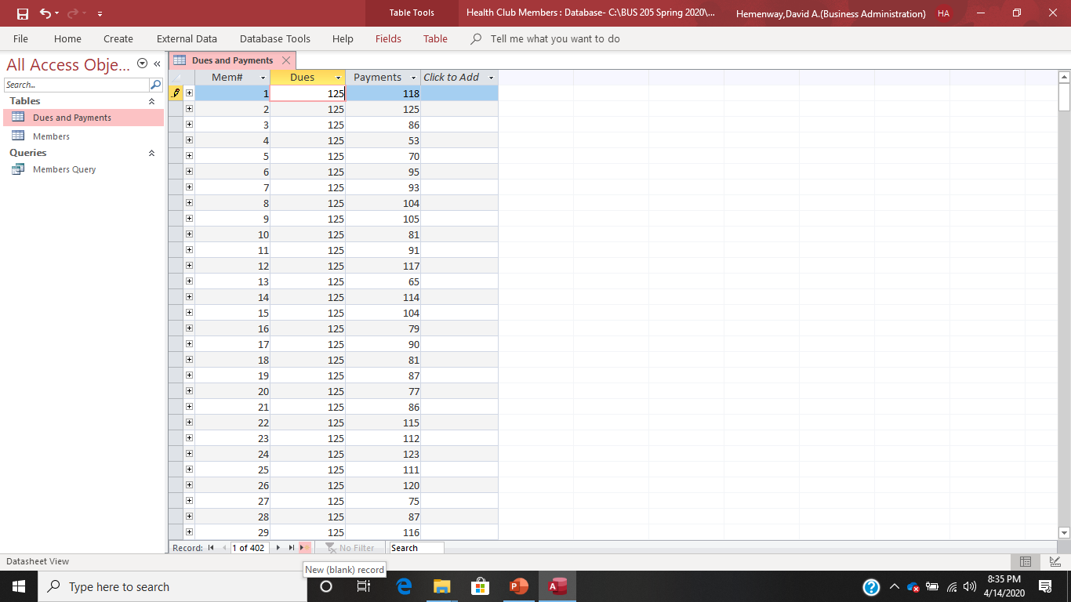
Let’s see if our validation rule worked. Switch to Datasheet View and click on the New (blank) record button which has the yellow * beside it.

Slide 22
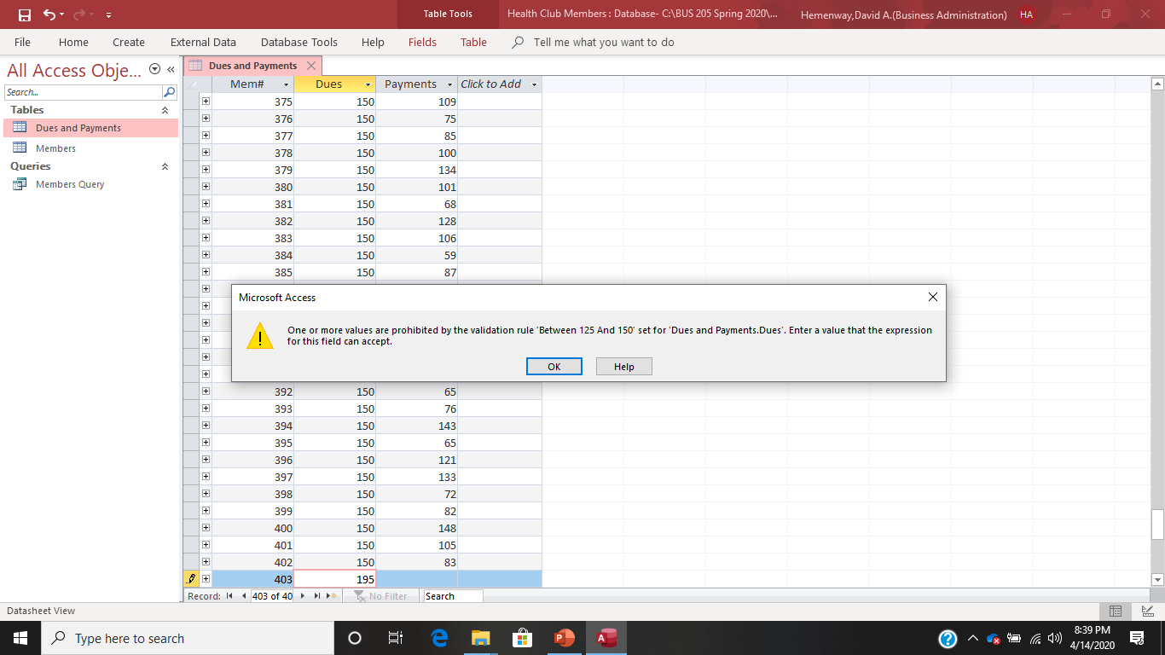
Enter 403 for the Mem# and dues of 195 and see what happens. It works!

Slide 23
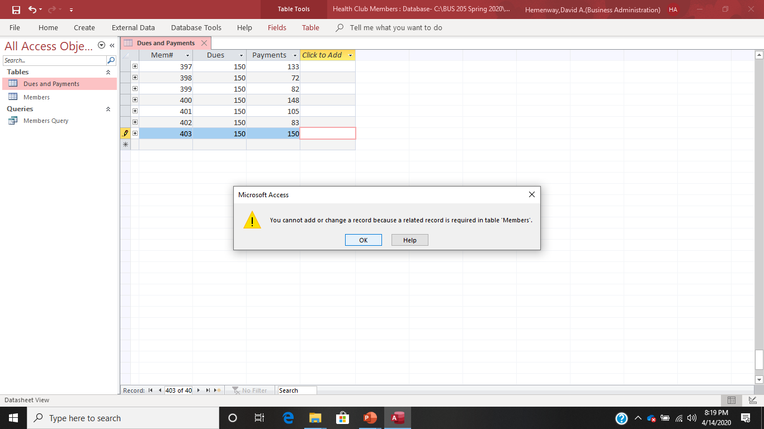
Validation Rule Example Set a validation rule for dues of

Slide 24
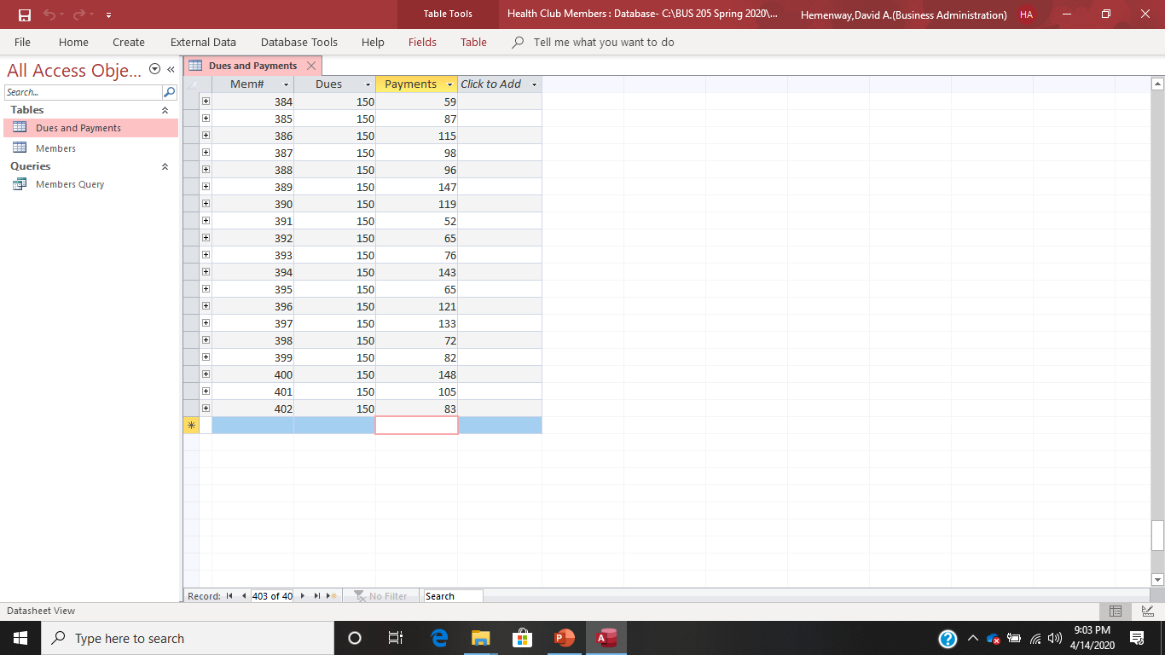
To remove this record in Dues and Payments hit the esc key on your keyboard. This removes the record from Access.

Slide 25

Since the error message we received wasn’t very helpful, let’s make a helpful one by adding Validation Text which is right below the Validation Rule row in the Field Properties area.

Slide 26

Simply key in your message in the Validation Text row.

Slide 27
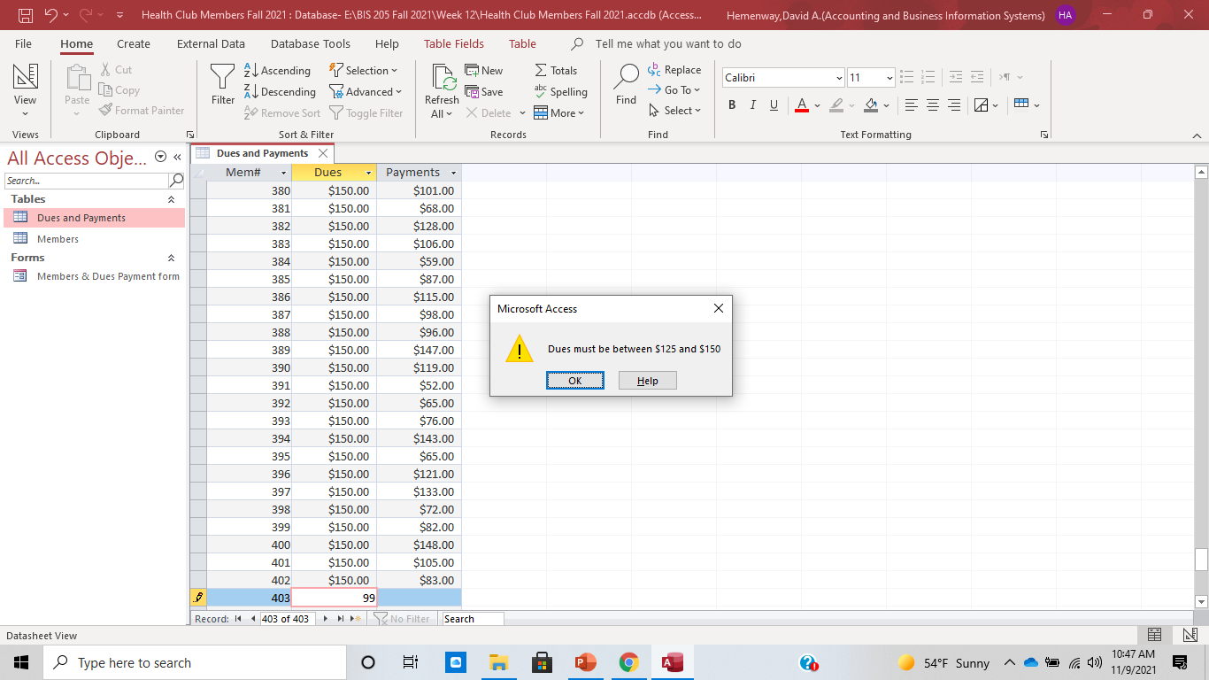
See if the Validation Text works:

Slide 28
Do these on Your Health Club Membership Database:
Change the format of each field to currency, text, etc.
Make dues required
Put an appropriate input mask on Phone
Dues must be greater than 100
Add Validation Text of “Dues must be greater than $100”
Make Phone a required field Verify these changes work by entering a new record and then deleting that record so your Health Club Members database isn’t messed up.

